Slide 2
What You Never Knew the IRS Will Let You Do
BECKY LARAMEE
Becky From Boston All Points Limousine
Laramee Tax & Accounting

Slide 3
Welcome & Thank You to Our Sponsors

Slide 4
It’s Your American Duty
To Pay Accurate Taxes
The tax code is meant to be interpreted to pay proper taxes
Tax code is 6,871 pages, interpretation 75,000 pages
Paying your fair share creates economic growth
Lowering your tax burden creates cash flow to infuse into the economy
Government TAX incentives address economic and social issues
Business owners can leverage tax incentives to solve the proposed issues

Slide 5
Tax Credits
What You Never Knew the IRS Will Let You Do
FORM 3800 GENERAL BUSINESS CREDITS
Form 3468 Investment Credit
Form 5884 Work Opportunity Credit
Form 6478 Alcohol and Cellulosic Biofuel Credit
Form 6765 Credit for Increasing Research Activities
Form 8834 Qualified Plug-in Electric and Electric Vehicle Credit
Form 8835 Renewable Electricity, Refined Coal, and Indian Coal Production Credit
Form 8845 Indian Employment Credit
Form 8846 Credit for Employer SS/Medicare Taxes Paid
Form 8586 Low-Income Housing Credit
on Certain Employee Tips
Form 8820 Orphan Drug Credit
Form 8864 Biodiesel and Renewable Diesel Fuels Credit
Form 8826 Disabled Access Credit
Form 8874 New Markets Credit

Slide 6
Tax Credits
What You Never Knew the IRS Will Let You Do
FORM 3800 GENERAL BUSINESS CREDITS
Form 8881 Credit for Small Employer Pension Plan Startup Costs
Form 8882 Credit for ER-Provided Childcare Facilities/Services
Form 8896 Low Sulfur Diesel Fuel Production Credit
Form 8900 Qualified Railroad Track Maintenance Credit
Form 8906 Distilled Spirits Credit
Form 8908 Energy Efficient Home Credit
Form 8910 Alternative Motor Vehicle Credit
Form 8911 Alternative Fuel Vehicle Refueling Property
Credit
Form 8923 Mine Rescue Team Training Credit
Form 8932 Credit for Employer Differential Wage Payments
Form 8933 Carbon Dioxide Sequestration Credit
Form 8936 Qualified Plug-In Electric Drive Motor
Vehicle Credit
Form 8941 Credit for Small Employer Health Insurance
Premiums
Form 8994 Employer Credit for Paid Family and Medical Leave

Slide 7
Financial Blueprint
Where Are You Going?
Know which entity best suits your plan Sole prop ~ S-Corp ~ C-Corp
What are your 1-, 3-, 5-year goals
Financial statements reveal the need for tax credits
Tax credits are used to reduce tax liability
Tax strategy is using credits to implement an ongoing plan
Business sustainability starts with financial discipline
No taxes… is not an option for profitable businesses
Discover individual state’s credits (shorter life span)
Look for local municipal credits (TIF)
Industry-specific federal credits (school bus fuel credit)

Slide 8
Build
Relationships
Accountant
Banker
Mentor Group
Your Business
Creating a Dream Team
Attorney
Accountant – Aware of tax law changes that can impact business
Attorney – Informed on legal maneuvers
Relationship Banker – Has insight into the current and future economic climate
Leasing Agent – Experienced with shifts in industry-specific trends

Slide 9
Real World Expertise
Join a Group
Local BNI Chapter •
Industry-Specific Peer Group •
Industry-Specific Associations (NLA)
Chamber of Commerce Groups
Listen to experienced business owners
Gain insights on tax strategies and financial management from your peers, what do they do?
Surround yourself with successful like-minded people

Slide 10
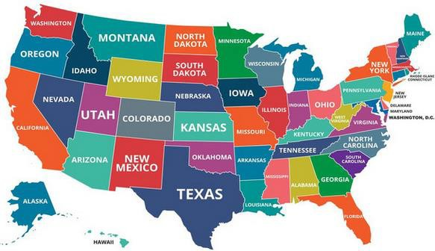
State Credits
What Does Your State Offer?
Best Tax Advantage States States That Offer Job Tax Credits
Texas
Alabama
Georgia
South Carolina
Mississippi
Tennessee
Virginia
Ohio
Kentucky
North Carolina – job creation grants
South Dakota
Nevada
Wyoming
States with Investment Tax Credits
California
Burdensome Tax States
New York
New York
New Jersey
Texas
Virginia
California
Rhode Island

Slide 11
Tax Strategy
What’s in It for Me?
Work Opportunity Tax Credit (WOTC)
HSA
Health Insurance Premium Credit
Pay your minor children through a management company
Home Office Reimbursement
Augusta Rule
Depreciation/Bonus and Section 179
Capital Gains Rate
Balance owner’s draw and W2 wage

Slide 12
Creating Advantages
Next-Level Tax Strategies
Self-Directed IRA
Family Trusts
Charitable Remainder Trust (CRT)
Corporate tax rate 15%?
Family Board Meetings
Real-Estate Tax Benefits
Short-Term Loophole
Cost Segregation
Accelerated Depreciation
Real-Estate Professional
Designation

Slide 13
Becky From Boston

Slide 14
Let Us Know How We Did!
Fill Out the Survey

Slide 15
Thank You for Joining Us!

